Slide 1

Predicting NBA Game Point Spread
Using Historical Game Data
Authors: Deric Liang, Dylan Brazier and Zakaria Ali

Slide 2





Introduction
What is the question you are working on?
Predicting point spreads for NBA games
Why is it interesting?
Valuable for analysts and teams for strategic planning
Significant global investment in the NBA (teams worth $74.4B, 1.6M viewers per game)

Slide 3




Motivation
ECONOMIC SIGNIFICANCE
NBA RECORDED $10.58B IN REVENUE IN 2022.
SPORTS BETTING MARKET EXPECTED TO HIT $9.65B IN 2024.
VIEWER ENGAGEMENT
NBA FINALS PEAK AT 20.4M VIEWERS

Slide 4




Data Description (source: Kaggle)
Historical NBA game data (2012-2018 seasons)
Vegas betting odds
Key features: points by quarter/OT, total points, assists, rebounds, turnovers, game location, FG/FT/3P percentages
Data size: 8.6 MB

Slide 5



Feature Engineering
Relevant features: total team wins/losses, average points/assists/rebounds
Experiment with using last 5/10/20 game aggregate statistics to reflect current performance.
Example features: number of games, avg PPG/FG/FT/3P

Slide 6
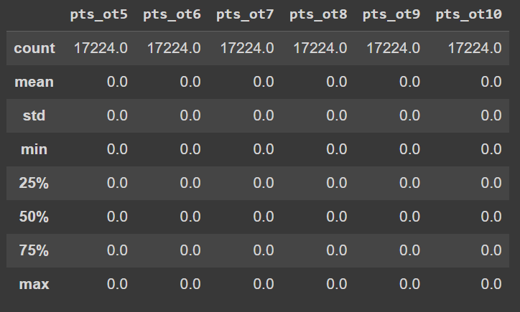
Exploratory Data Analysis

Slide 7
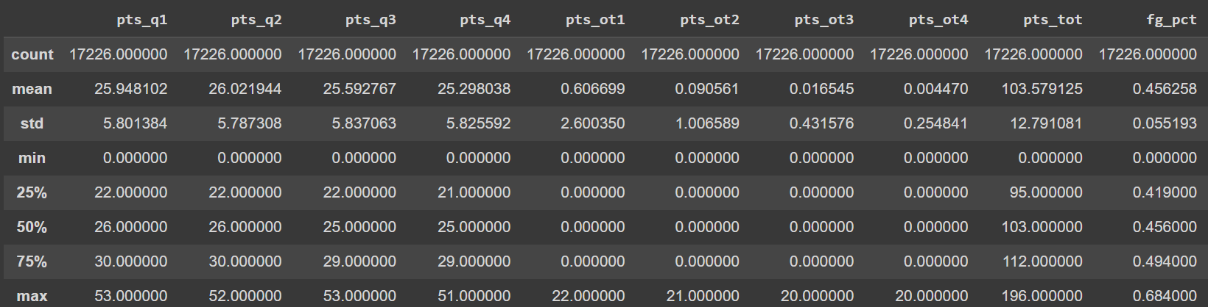
Exploratory Data Analysis

Slide 8
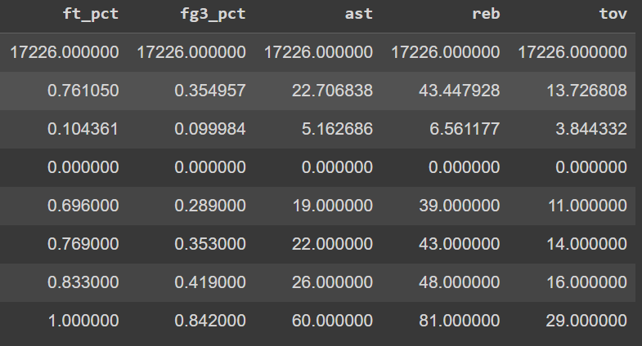
Exploratory Data Analysis

Slide 9
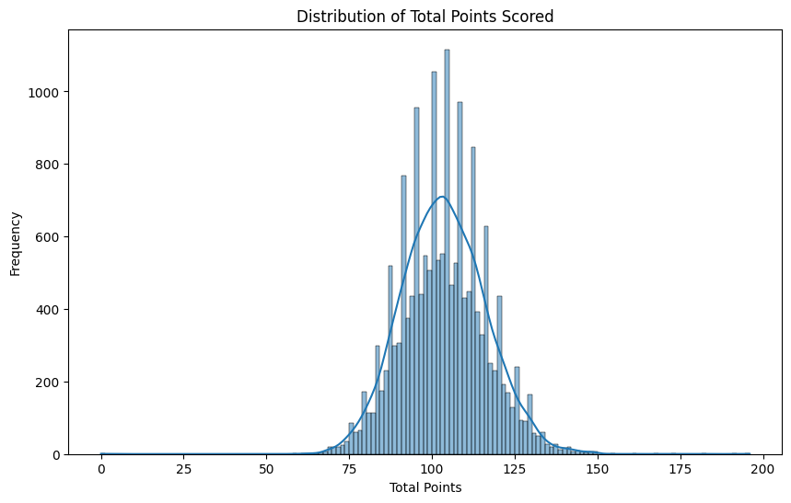
Exploratory Data Analysis

Slide 10
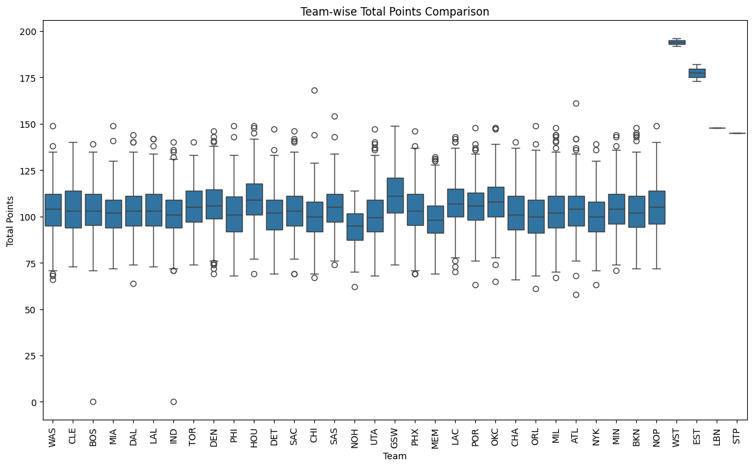
Exploratory Data Analysis

Slide 11
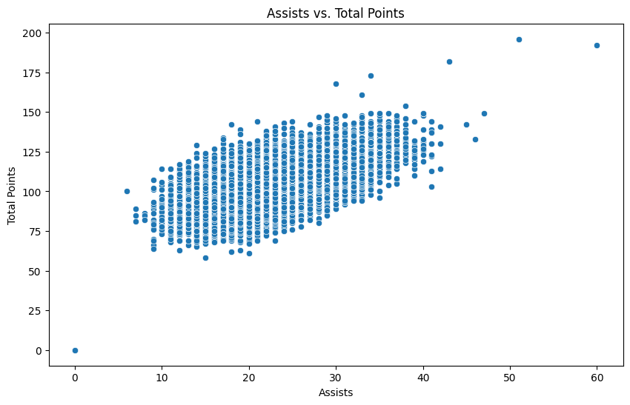
Exploratory Data Analysis

Slide 12



Random Forest
HOW IT WORKS: BUILDING TREES USING RANDOM SUBSETS, COMBINING TREES FOR PREDICTION
ADVANTAGES: PARALLEL COMPUTATION, AVOIDS OVERFITTING, REDUCES VARIANCE, PROVIDES FEATURE IMPORTANCE METRICS
DISADVANTAGES: COMPUTATIONALLY EXPENSIVE, REQUIRES HYPERPARAMETER TUNING

Slide 13



Linear Regression
HOW IT WORKS: MODELING RELATIONSHIP BETWEEN TARGET AND PREDICTORS WITH A BEST-FITTING LINE
ADVANTAGES: EASY TO INTERPRET, COMPUTATIONALLY CHEAP
DISADVANTAGES: ASSUMES LINEARITY, SENSITIVE TO OUTLIERS, CAN UNDERFIT

Slide 14




Neural Networks
How it works: various layers (input, hidden, output), non-linear transformations, adjusting weights based on error
Types: FNN (Feedforward Neural Networks) or RNN (Recurrent Neural Networks)
Advantages: models complex relationships, handles large data, versatile
Disadvantages: needs a lot of data, can overfit, hard to interpret

Slide 15
Evaluation Metrics
Performance metrics: Mean Squared Error (MSE), R-squared, Cross-validation (K-fold)
MSE: measures difference between actual and predicted values
R-squared: variance proportion between dependent and independent variables
Cross-validation assesses generalizability of results

Slide 16


Results and Comparison
Compare against regression baseline and Vegas predicted spreads.
Expected outcomes and interpretations.

Slide 17



Conclusion and Future Work
Summary.
Importance of results for NBA teams and analysts
Future work: refining models, exploring additional features, real-time predictions.

Slide 18

Q&A

